Slide 1
ANDROID BASED MOBILE APPLICATION (FUN BOX)
S
T
A
R
S
SATYA VENKATA KRISHNA ACHANTA
ROBIN KUMAR
SHIVA SAI GOUD PABBA

Slide 2
INTRODUCTION
In todays generation smart phones have opened mobile applications to a wide audience.
This android application is built using Android Studio with AVD(Android Virtual Device) and SDK(software development kit).
Through this project one can know how to create layouts, custom views, playing music , sound effects, and getting user input from the touch screen

Slide 3
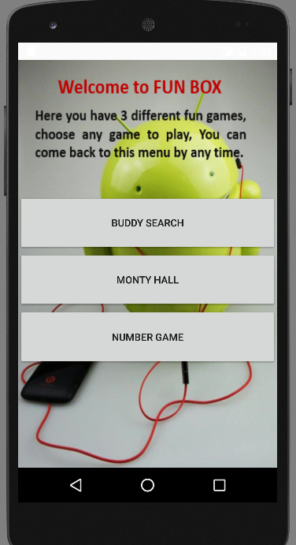
OBJECTIVES OF THE GAME
What Exactly app(FUN BOX) contains
Main menu appears with 3 user options like:
1-Buddy Search application
2-Monty Hall game
3- Number game
FUN BOX is also a mobile gaming application
which is supported by the android devices.
The main goal of this app is to entertain all the users
with 3 different sub games with effective user interface and validations.

Slide 4
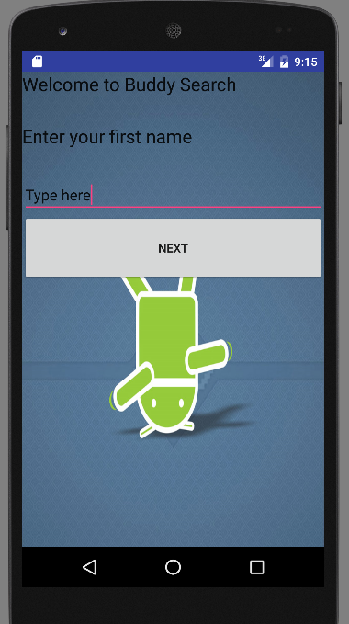
1-Buddy Search
What it Includes?
It gives a best friend name
according to given set inputs.

Slide 5
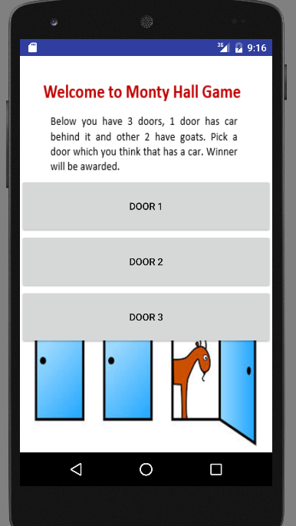
2- Monty Hall Game
it is a puzzle game,
on it user have to choose a door that has a prize behind it among other two doors- like hide & seek game with goat and a car
At the end user will be awarded if he won

Slide 6
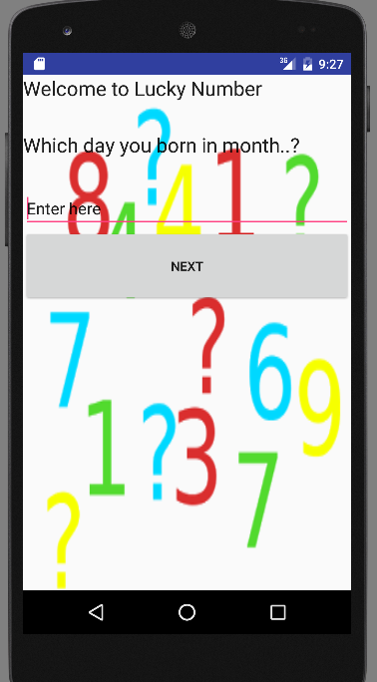
3-Lucky Number
It shows a lucky number with a quote by taking some information from user.

Slide 7
Design & Implementation

Slide 8
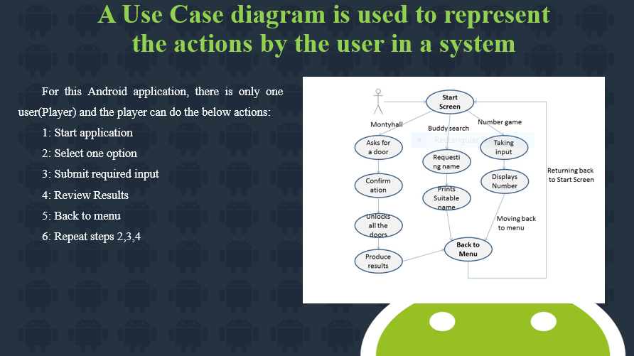
Design
Design is the first step in the development phase for any techniques for the purpose of defining a device, a process or system in sufficient detail to permit its physical realization.
Unified Modeling Language Diagrams- EDRAW
The unified modeling language allows the software engineer to express an analysis model using the modeling notation that is governed by a set of syntactic semantic and pragmatic rules.

Slide 9
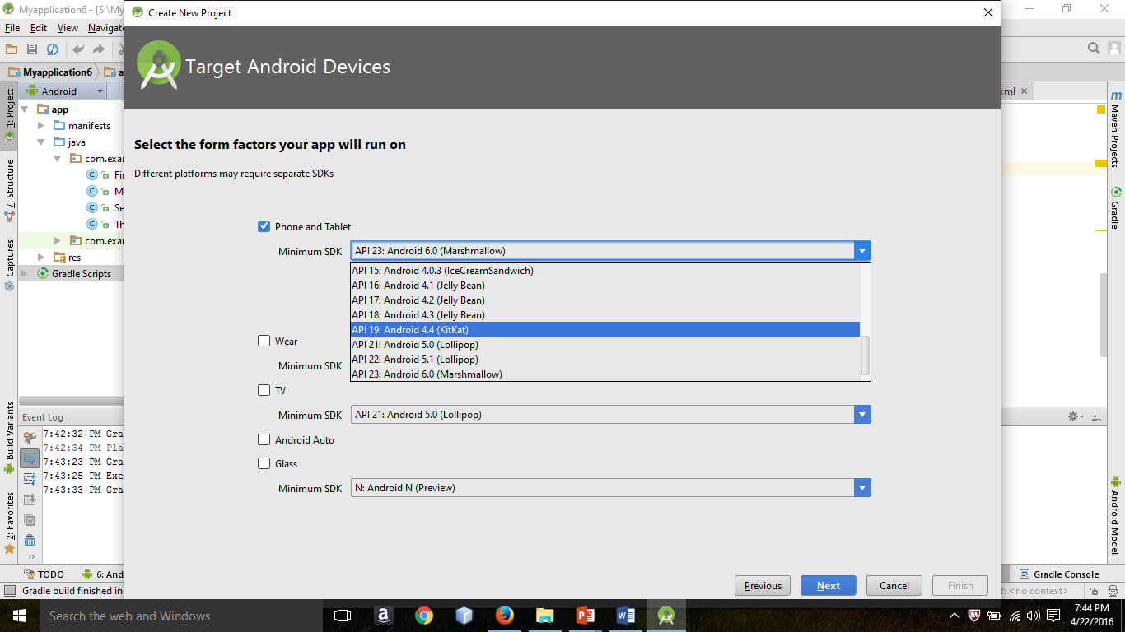
Implementation
Steps included:
Download and install Android Studio Followed by
Java Development Kit(JDK)
Technologies used:
Java
Basic Xml
Target device:
Open new project by selecting a android version to accept that application

Slide 10
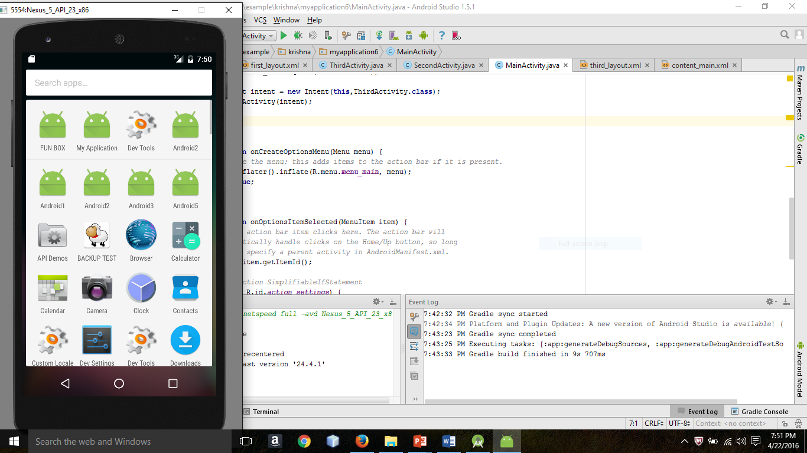
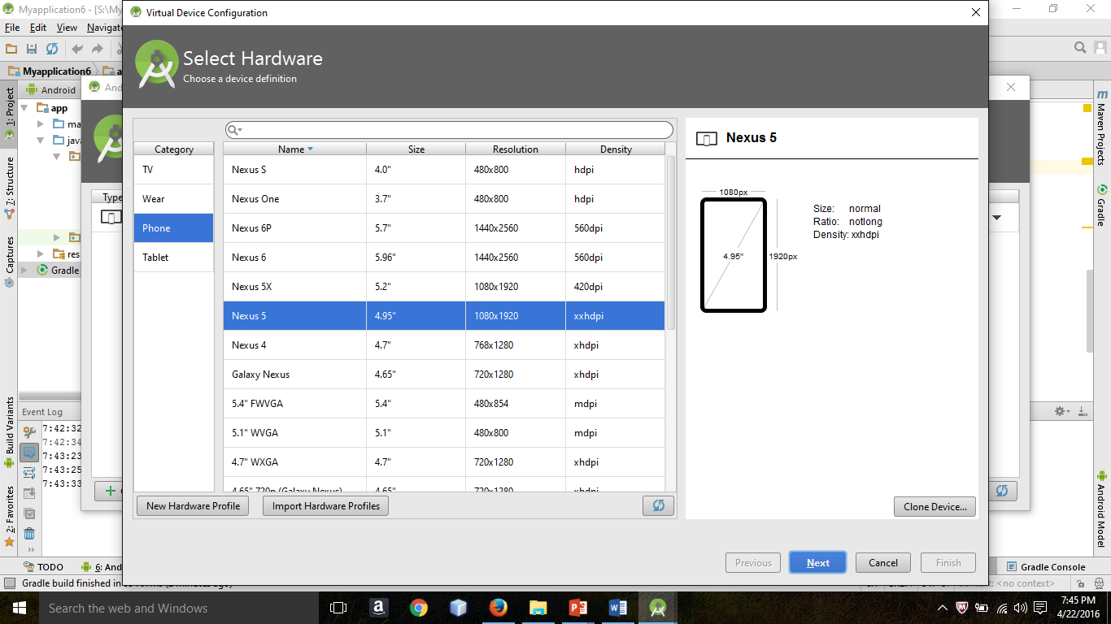
Implementation
Select a target Android Virtual Device(AVD) to run your application

Slide 11
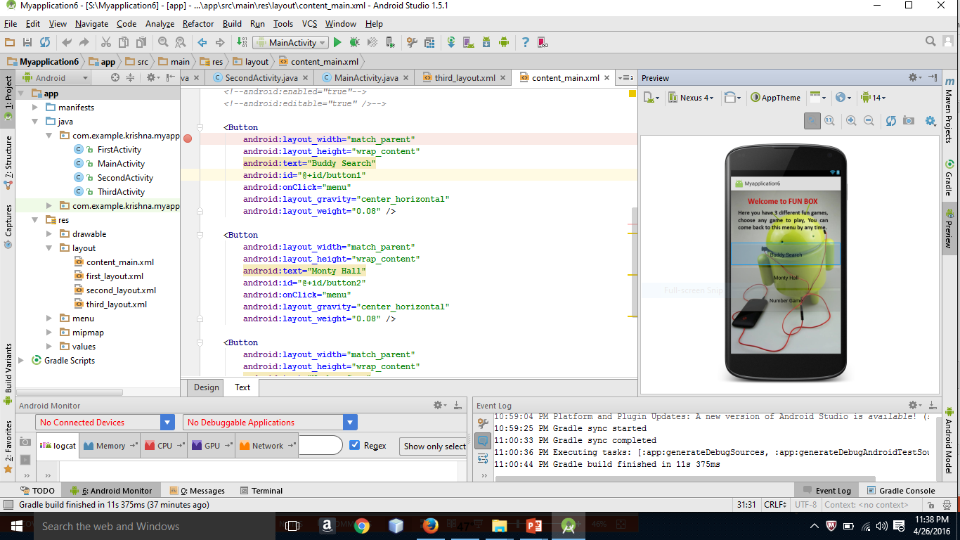
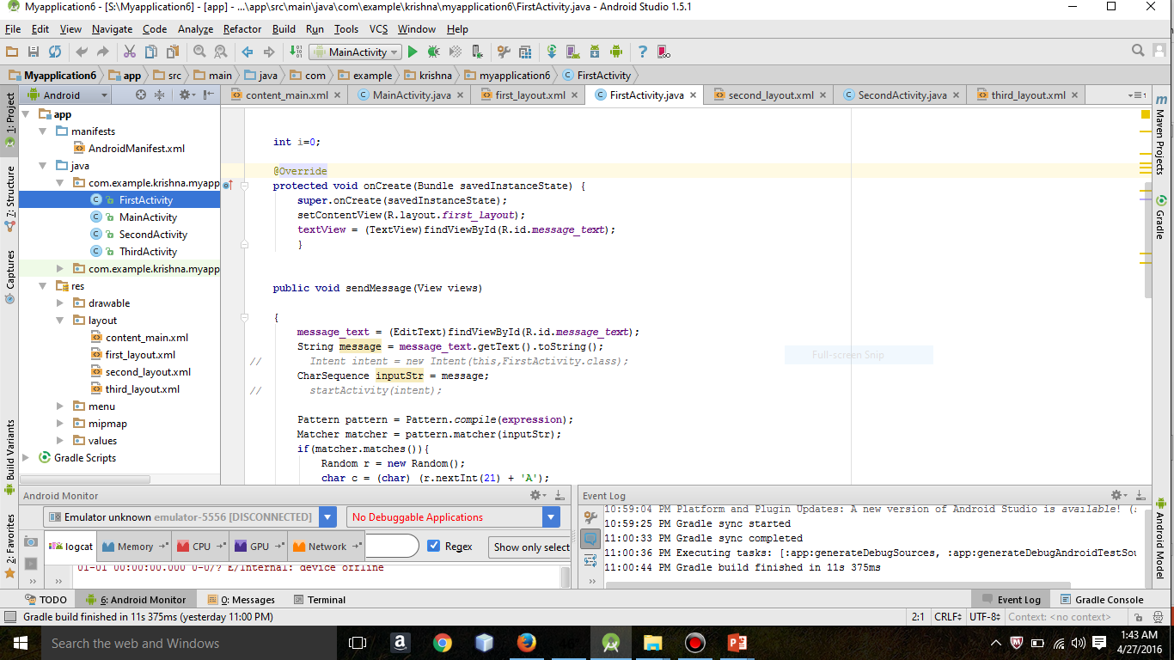
Inside the Project

Slide 13
Testing & Conclusion

Slide 14
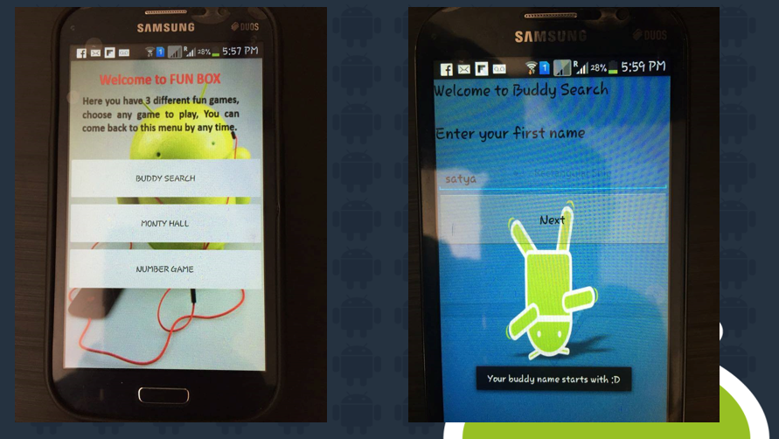
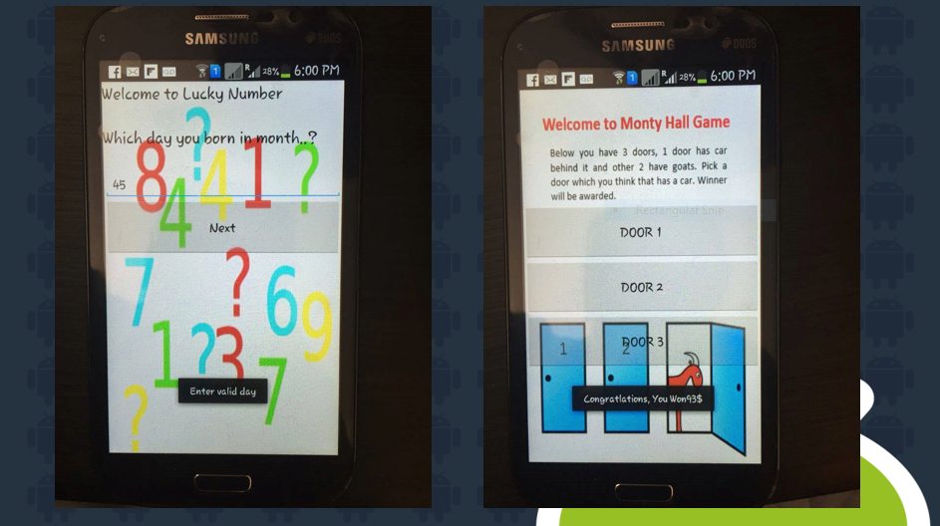
Verifications & Validations
Start page: Application must shows initial screen
Application: It has to produce at least 3 apps
Access: Each application must have redirect to main menu
Display: It has to display all 3 games clearly
Validations: User has to enter require input
System must accept numbers while taking door number in Monty hall game
It has to accept one string as a name while using buddy search
Compatibility: The system must run in to any android device

Slide 15

What we learned.?
By implementing this project one can know how to understanding the value of designing the components of overall application before implementing them.
The project also taught us application programming skills and refining the design and implementation logic of the software at every phase of the development life cycle to improve the overall performance of the application.
Mainly this app helps to create awareness on mobile application development
ANY QUERIES ?
Thank you all

